Slide 1


REET TECHNOLOGIES
Where Ideas Meet Execution…
Future Tech IT solutions & Strategic Consulting
Contact Us
reettech24@gmail.com
7972905758

Slide 2

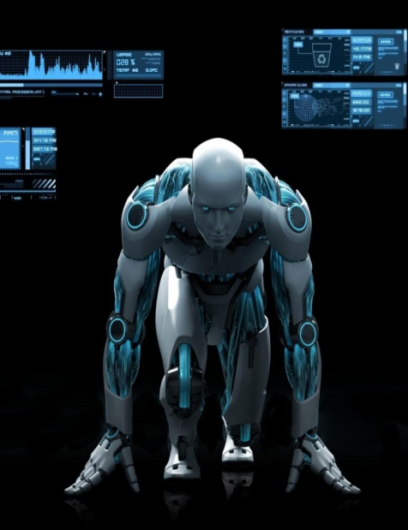
What Is we Learn?
Discipline
Time Management
Technologies
Overall Personality Development
Departmental Works
Operating Tools
Linked in and Other Portals

Slide 3
What Is IT?
Information technology World is full of Innovations, Technology and New Vision and New Ideas.
Innovations and New Vision:
The IT world is continuously evolving with innovations, bringing new ideas and perspectives.
Hardware:
Physical components of a computer system such as:
Computers
Servers
Storage devices

Slide 4
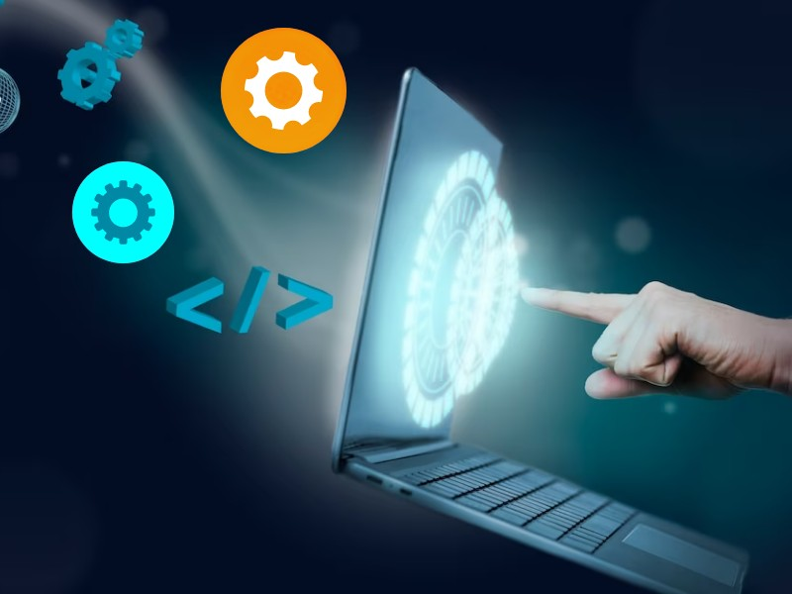
Software?
Software:
Programs and operating systems that run on hardware, including:
Windows
Linux
Application software

Slide 5
Key Components of IT
Networking
Connecting computers and other devices to share resources, including:
Local Area Network (LAN)
Wide Area Network (WAN)
Internet
Databases
Organized collections of data that can be easily accessed, managed, and updated.
Cyber security
Protecting systems, networks, and data from digital attacks, damage, or unauthorized access.
IT Support and Services
Maintenance and support of IT infrastructure, helping users resolve technical issues.

Slide 6
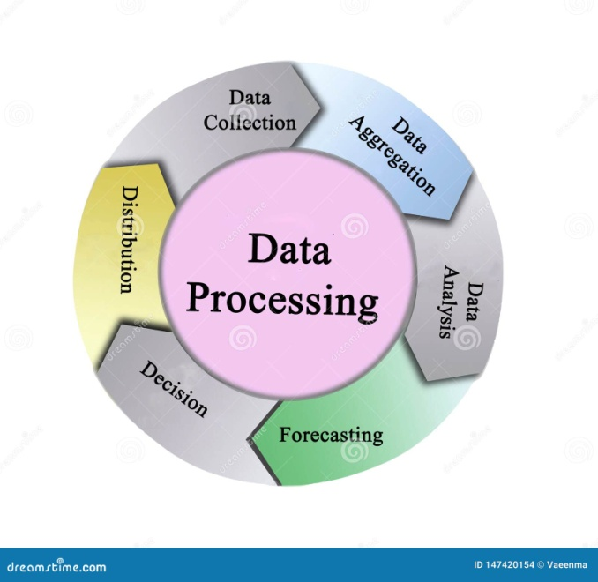
Internet of Things - IOT
The Internet of Things (IoT) refers to the network of physical objects or "things" embedded with sensors, software, and other technologies to connect and exchange data with other devices and systems over the internet. These objects range from everyday household items to sophisticated industrial tools.
Key Components of IoT
Devices:
Sensors and Actuators: Collect data from the environment and perform actions.

Slide 7

Connectivity
Networks and Protocols: Enable devices to communicate with each other and with central systems.
Examples: Wi-Fi, Bluetooth, Zigbee, cellular networks, LoRaWAN.
Data Processing:
Edge Computing: Processes data locally on the device or nearby to reduce latency.
Cloud Computing: Centralized data processing and storage, providing scalability and advanced analytics.
Applications and Dashboards: Allow users to interact with IoT devices and analyze data.
Examples: Mobile apps, web interfaces, voice assistants.

Slide 8
Benefits & Challenges of IOT
Benefits of IoT
Efficiency and Productivity
Cost Savings
Improved Decision Making
Enhanced Customer Experience
Innovation
Automates routine tasks and optimizes resource usage, leading to increased efficiency and productivity.
Reduces operational costs through predictive maintenance and efficient resource management.
Provides real-time data and analytics for better decision-making and strategic planning. Offers personalized and responsive services to improve customer satisfaction and engagement.
Enables the development of new business models and innovative solutions across various industries.

Slide 9
Challenges in IOT
Challenges of IoT
Security and Privacy
Interoperability
Data Management
Scalability
Regulation and Standards
Protecting data and devices from cyber threats and ensuring user privacy is a major concern. Ensuring that different IoT devices and systems can work together seamlessly.
Handling the vast amounts of data generated by IoT devices and extracting meaningful insights.
Managing and scaling IoT solutions as the number of connected devices grows. Navigating the regulatory landscape and adhering to industry standards.

Slide 10
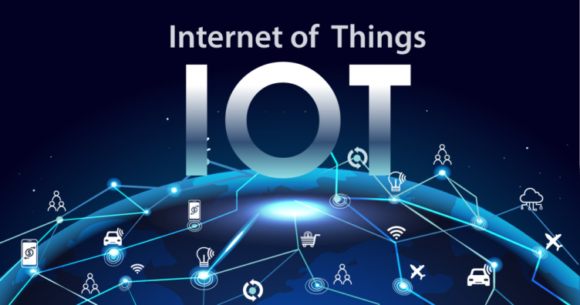
Examples of IOT
Transportation and Logistics
Optimizing transportation systems and supply chains through data-driven insights.
Fleet management
Real-time tracking of goods
Smart traffic management
Smart Homes
Automating and controlling home appliances and systems for convenience, security, and energy efficiency.
Smart thermostats
Smart lights
Security cameras
Smart locks
Industrial IoT (IIoT)
Enhancing manufacturing, supply chain, and industrial processes through automation and data analytics.
Predictive maintenance
Asset tracking
Smart factories

Slide 11
Departments in IT
Micro | Small | Mid Level | Higher Management
Tech Support | Legal | Sales & Marketing | VP Sales
Operations | Customer Relation | R & D | Director
Admin | Sales Executive / Inside Sales | Finance & Accounting | CEO,CFO
Pre-Sales | Junior Marketing | HR Dept | Stake Holders
 | Business Analysis | Business Analysis | Partners
 | Junior Project Management ex | Project Management | Project Managers
 | Jnr Developers/UIUX | Snr Developers / UIUX | Full Stack

Slide 12
Domains In IT industry
Domain are the Sectors of Business
Domain are the Sectors of Business where IT services play a vital role for enhancement of Production, business, Process, Operations and More.
Manufacturing
Real Estate
Supply Chain
Healthcare
Solar
Travel Tourism
E-Commerce
Agriculture
FMCG
Education
Retail
IT Companies

Slide 13
What are Softwares & Applications?
Software: Programs and applications that run on computers and other devices. Includes operating systems (e.g., Windows, macOS), productivity tools (e.g., Microsoft Office), and specialized applications (e.g., Photoshop).
Mobile Apps: Applications designed to run on mobile devices such as smartphones and tablets. Available through app stores (e.g., Google Play, Apple App Store). Examples: Instagram, WhatsApp, mobile banking apps. (2 Types of Mobile Apps – Hybrid & Native)
Web Apps: Applications accessed via web browsers over the internet. Do not require installation on a device; they run on web servers. Examples: Google Docs, online shopping sites, web-based email services (e.g., Gmail).

Slide 14
What are Softwares & Applications?
Mobile App
Web App
Website
Hybrid
Android + IOS
Transactions
Shows Only Information
Native
Android / IOS
Interactive
Static or
Dynamic

Slide 15
What are Products & Services?
IT Services
IT services encompass a broad range of activities and support provided by IT professionals to manage, operate, and maintain IT systems and infrastructure. These services are designed to ensure the smooth functioning of an organization's technology environment and to support its business goals. Here are the key types of IT services:
Cloud Services
Testing Services, Database Management ,Services Sales & Marketing Services ,Technical Support Services, Digital Marketing, Customer Relationship Management
IT Products
Its an Service application or software developed by an Individual or a Company for Specific Purpose with Specific Target
PRODUCTS
Custom Software Custom Mobile App Custom Web App Examples Serv India Amazon Flipkart

Slide 16
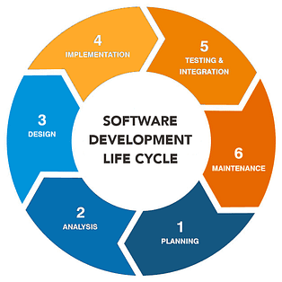
SDLC
**SDLC (Software Development Life Cycle)** is a process used by software developers to design, develop, and test high-quality software. It consists of several phases:

Slide 17
PHASES IN SDLC
Planning/ BRD
Define the project scope and objectives. Identify resources, timelines, and budget. Conduct feasibility studies and risk assessments.
Requirements Analysis
Gather and document functional and non-functional requirements. Engage with stakeholders to ensure all needs are captured.
Design
Create architectural designs and detailed specifications. Plan the system architecture, database design, and user interfaces.
Development
Testing
Write the actual code based on design documents. Develop software components and integrate them.
Perform various testing (unit, integration, system, acceptance) to identify and fix bugs. Ensure the software meets all requirements and functions correctly.

Slide 18
SDLC & METHODOLOGY
Deployment
Release the software to a production environment. Perform necessary configurations and provide user training.
SDLC Models
Waterfall Model: Sequential approach where each phase must be completed before the next begins. Agile Model: Iterative approach with continuous feedback and improvements. DevOps: Combines development and operations for faster delivery and continuous integration.
Maintenance
Monitor the software for any issues or bugs. Provide updates and enhancements to improve functionality and address any problems.
Model Selection
Each model has its own strengths and is chosen based on project requirements and constraints.

Slide 19
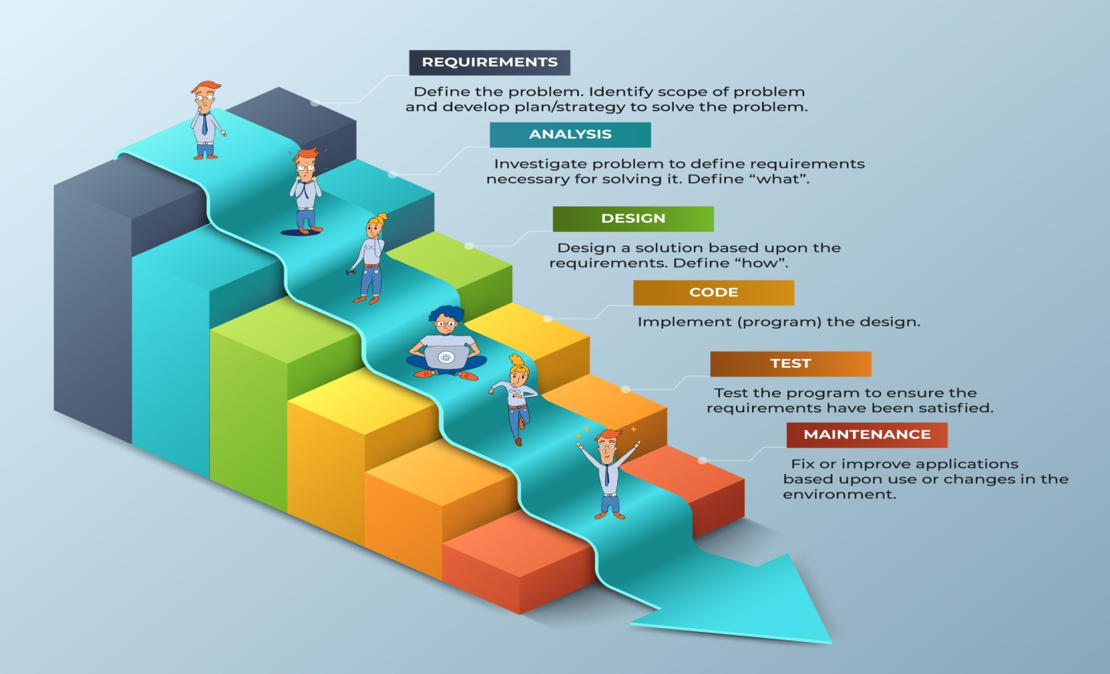
Waterfall Methodology
Extreme Dependency on One Task to Other

Slide 20
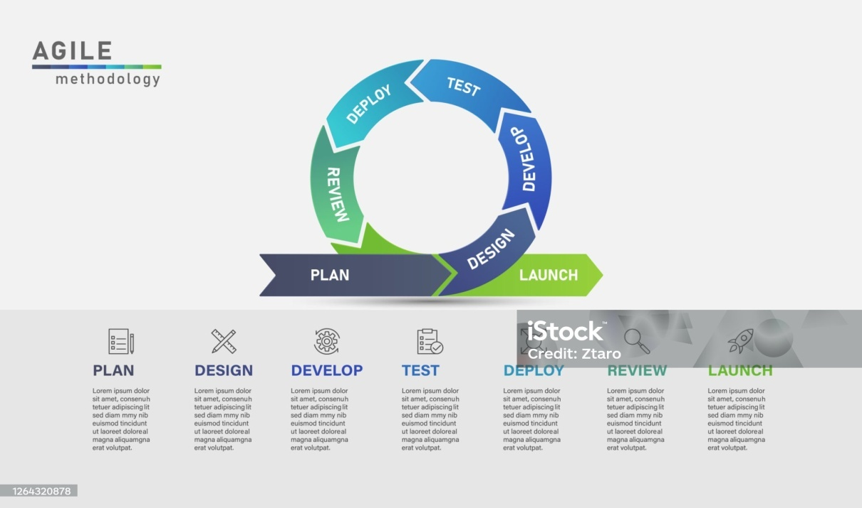
Agile Methodology
Iterative Development
Work is divided into small, manageable units called sprints (typically 2-4 weeks). Each sprint results in a potentially shippable product increment.
Flexibility and Adaptation
Ability to adapt to changes quickly, even late in the development process. Priorities and requirements can be adjusted based on feedback and evolving needs.

Slide 21
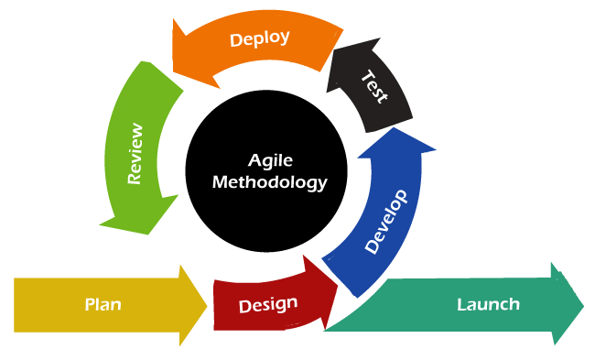
Customer Collaboration
Continuous involvement of stakeholders and customers throughout the development process. Regular feedback helps ensure the product meets user needs.
Cross-Functional Teams
Teams are self-organizing and include members with diverse skills. Collaboration among team members is emphasized.

Slide 22
Cloud & Database Management
Cloud Technology | Database Management
Delivery of computing services over the internet | Use of software to store, manage, and retrieve data efficiently
Includes IaaS, PaaS, and SaaS | Involves organizing data for easy access and manipulation
Benefits: scalability, cost efficiency, accessibility, reliability, security | Ensures data integrity, security, and consistency

Slide 23
What is Cloud Technology?
Infrastructure as a Service (IaaS) | Platform as a Service (PaaS) | Software as a Service (SaaS)
Provides virtualized computing resources over the internet. Includes servers, storage, and networking. Examples: Amazon Web Services (AWS), Microsoft Azure, Google Cloud Platform (GCP). | Offers hardware and software tools over the internet. Designed to support application development and deployment. Examples: Google App Engine, Play store, Microsoft Azure PaaS, Heroku. | Delivers software applications over the internet on a subscription basis. Users can access the software through a web browser. Examples: Google Workspace, Microsoft 365, Salesforce.

Slide 24
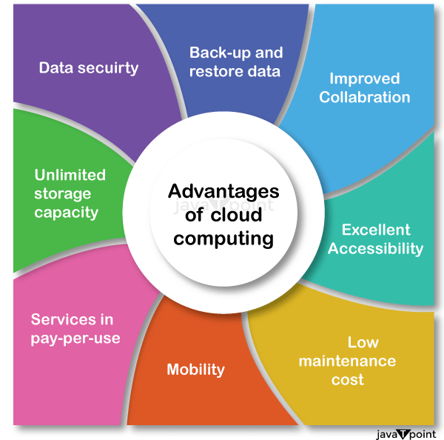
Benefits of Cloud Technology
Benefits of Cloud Technology
Scalability
Easily scale resources up or down based on demand.
Cost Efficiency
Reduce the need for upfront capital investment in hardware and software.
Accessibility
Access services and data from anywhere with an internet connection.
Security
Leverage advanced security measures and compliance certifications offered by cloud providers.

Slide 25
What is Database Management?
Relational Database Management System (RDBMS)
Organizes data into tables (relations) consisting of rows and columns.
Uses Structured Query Language (SQL) for querying and managing data.
Examples: MySQL, PostgreSQL, Oracle Database, Microsoft SQL Server.
NoSQL Database
Designed for unstructured or semi-structured data, offering flexible schema design.
Supports a variety of data models, including document, key-value, column-family, and graph.
Examples: MongoDB (document), Redis (key-value), Cassandra (column-family), Neo4j (graph).

Slide 26
Database Systems
Object-Oriented Database Management System (OODBMS)
Stores data in the form of objects, as used in object-oriented programming. Integrates with object-oriented programming languages for seamless data management. Examples: ObjectDB, db4o.
Hierarchical Database Management System (HDBMS)
Organizes data in a tree-like structure with parent-child relationships. Efficient for applications with hierarchical data structures. Examples: IBM Information Management System (IMS).
Network Database Management System (NDBMS)
Similar to HDBMS but allows more complex relationships with a graph-like structure. Supports many-to-many relationships between data entities. Examples: Integrated Data Store (IDS), Raima Database Manager.
Columnar Database Management System
Stores data by columns rather than rows, optimized for read-heavy operations. Suitable for data warehousing and analytics. Examples: Apache HBase, Google Bigtable.

Slide 27
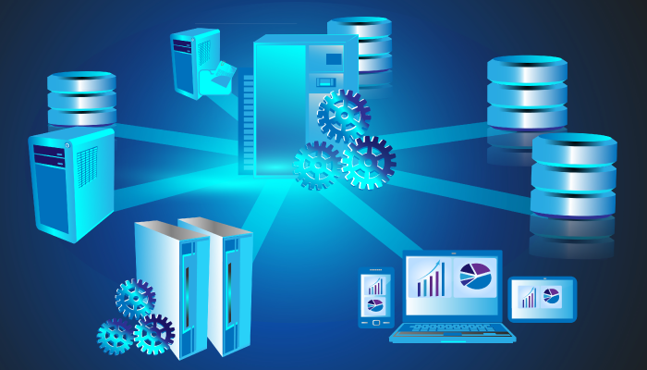
Database Management Systems (DBMS)
Database Management Systems (DBMS) are software applications that are used to create, maintain, and access databases.
They provide a structured way to store, organize, and retrieve data, making it easier to manage and analyze information. There are different types of DBMS, each with its own strengths and weaknesses.

Slide 28
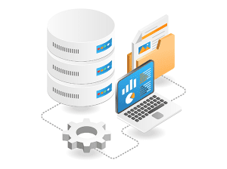
Types of Database Management
Distributed Database Management System (DDBMS)
Data is distributed across multiple physical locations.

Slide 29
Key Functions of DBMS
Data Storage and Retrieval | Efficiently stores and retrieves data as required.
Data Security | Protects data against unauthorized access and breaches.
Data Integrity | Maintains accuracy and consistency of data over its lifecycle.
Backup and Recovery | Provides mechanisms for data backup and recovery in case of failures.
Concurrency Control | Manages simultaneous data access by multiple users without conflicts.
Data Management | Supports data modeling, indexing, and query optimization for efficient data processing.

Slide 30
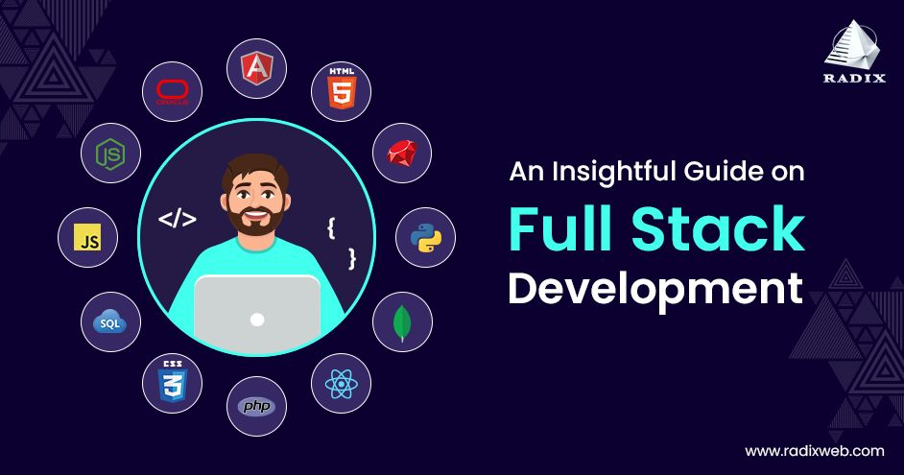
Technologies & Technical Stacks

Slide 31
Technologies & Technical Stacks
Programming Languages
A programming language is a formal set of instructions that a programmer uses to communicate with a computer. These instructions are written in a syntax and grammar that the computer can understand and execute to perform specific tasks or solve problems.
Used to write software code.
Python, Java, JavaScript, C#, Ruby on Rails

Slide 32
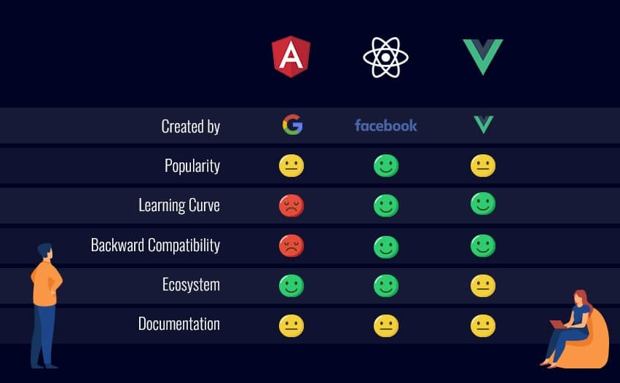
Frameworks and Libraries
framework in software development is a reusable, pre-built structure or set of tools that provides a foundation for building and organizing applications. It offers a consistent and organized way to develop software by providing standard ways to handle common tasks, enforce best practices, and integrate various components
Provide reusable code and tools to speed up development.
•Web Development: React JS, Angular, Vue.js (front-end); Express, Django, Flask (back-end).
•Mobile App Development: React Native, Flutter, Swift, Kotlin.

Slide 33
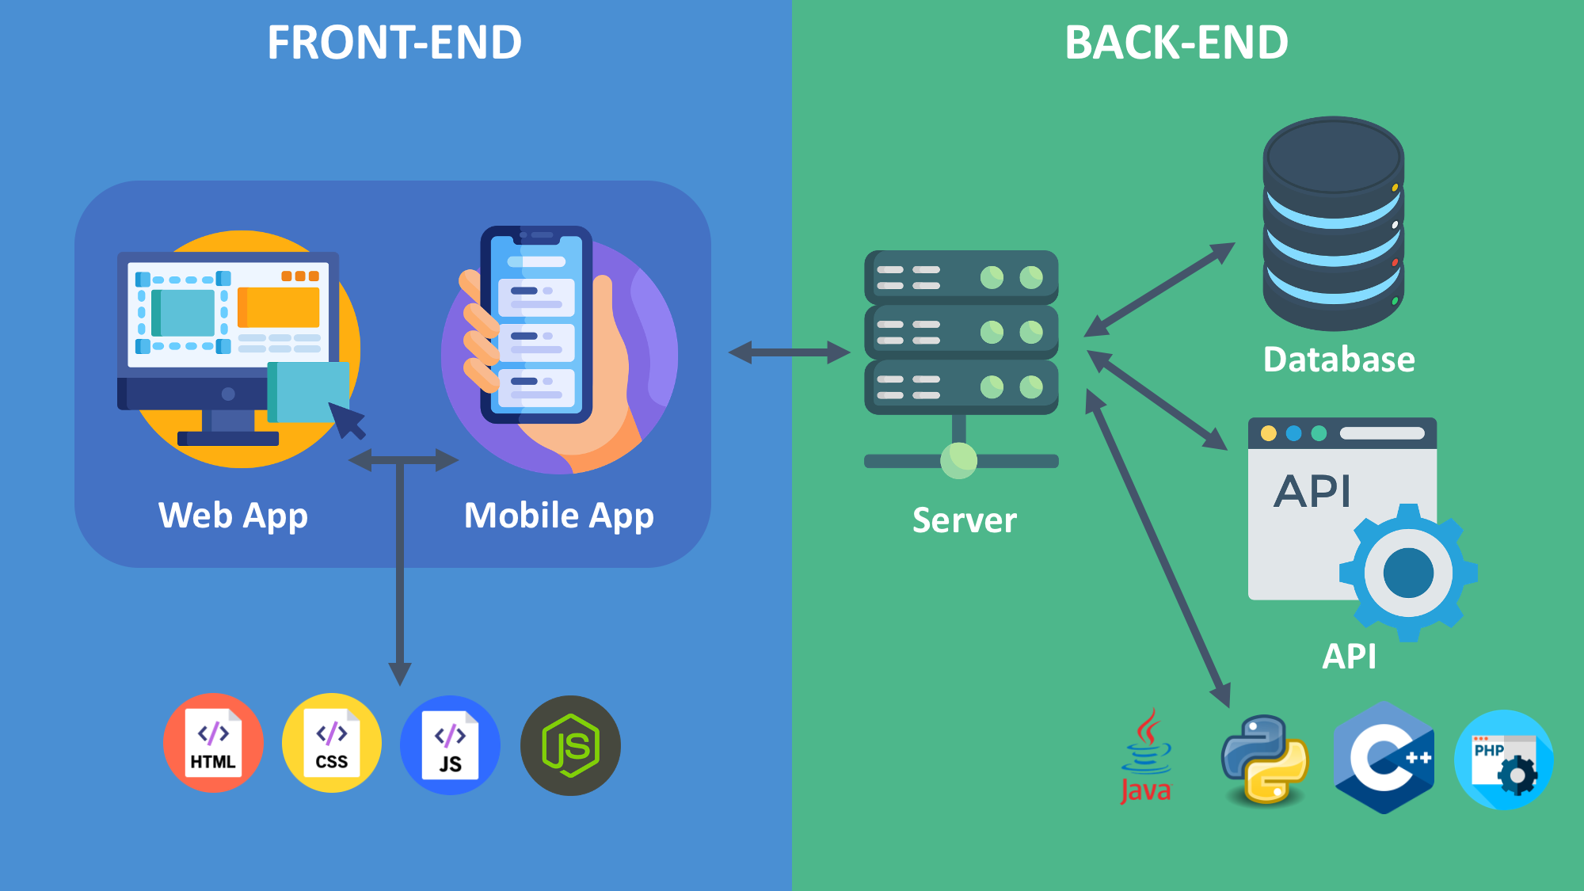

Slide 34
Technical Stacks
MEAN Stack
MongoDB: NoSQL database. Express.js: Web application framework for Node.js.
Angular: Front-end web framework.
Node.js: JavaScript runtime for server-side programming.
MERN Stack
MongoDB: NoSQL database.
Express.js: Web application framework for Node.js.
React: Front-end library for building user interfaces.
Node.js: JavaScript runtime for server-side programming.
Django Stack
Python: Programming language.
Django: High-level Python web framework.
PostgreSQL: Relational database.
Nginx: Web server.
LAMP Stack
Linux: Operating system.
Apache: Web server.
MySQL: Relational database.
PHP: Server-side scripting language.

Slide 35
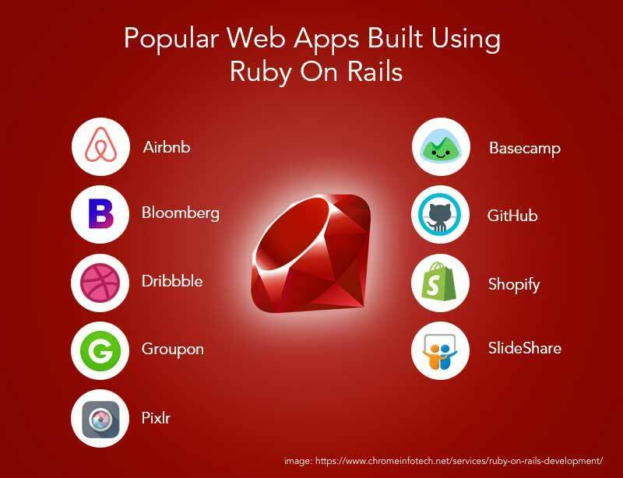
Ruby on Rails Stack
Ruby: Programming language.
Rails: Web application framework written in Ruby.
SQLite/MySQL/PostgreSQL: Relational databases.
Puma/Nginx: Web servers.
Java Full Stack
Docker & Kubernetes
Rest,Rest Full, Microservices,RDBMS,NoSQL,API
React JS, NodeJS, HTML,HTML5,CSS,
Bootstrap,JavaScript,
Frame works - Mocha, Jasmine, Karma, JEST
Messenger - Postman, Kafka, ActiveMQ or RabbitMQ

Slide 36
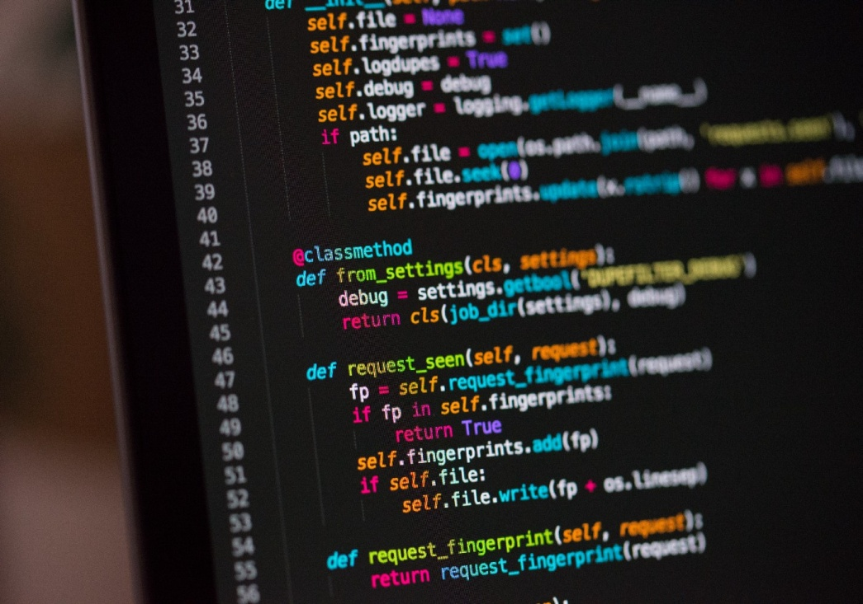
Choosing a Technical Stack
Project Requirements and Goals
Scalability
Security and Compliance
Team Expertise
Community Support and Ecosystem
Time to Market
Cost and Budget
Compatibility with Existing Systems
Performance Needs
Long-Term Maintenance and Support
Flexibility for Future Enhancements
Vendor Lock-In Risks

Slide 37
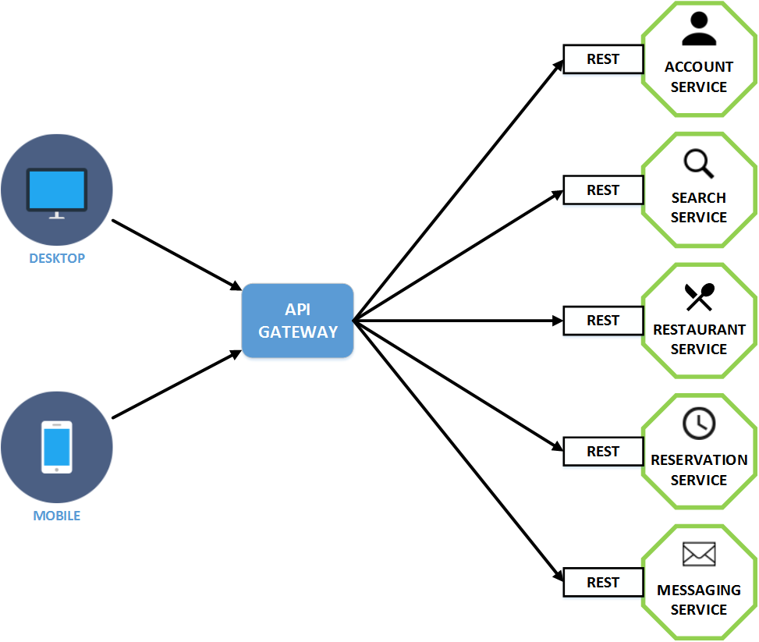
API

Slide 38
What is API ?
Application Programming interface
It is a collection of communication protocols and subroutines used by various programs to
communicate between them. It is a Connecting tool between 2 Applications to Exchange the Data.
A programmer can make use of various API tools to make their program easier and simpler
Types of APIs
Web API - Local API - Programme API
What are REST APIs?
REST stands for Representational State Transfer, and follows the constraints of REST architecture allowing interaction with RESTful web services. It defines a set of functions (GET, PUT, POST, DELETE) that clients use to access server data. The functions used are:
GET (retrieve a record)
PUT (update a record)
POST (create a record)
DELETE (delete the record)

Slide 39
What is API ?
Types of APIs
1. Web API - A Web API also called Web Services is an extensively used API over the web and can be easily accessed using the HTTP protocols. A Web application programming interface is an open-source interface and can be used by a large number of clients through their phones, tablets, or PCs. Web API Is simply an API for the web. It is an API that can be accessed using the HTTP protocol. It can be built using Java, .Net
2. LOCAL APIs In this type of API, the programmers get the local middleware services. TAPI (Telephony Application Programming Interface), and .NET are common examples of Local APIs. A Local API, specifically, refers to an API that is hosted locally on your machine or within your network. This means that the services provided by the API are accessible only within a limited environment, such as a local development server or an intranet.
Local APIs are commonly used during the development and testing phases of software projects, allowing developers to simulate interactions with external systems without relying on a live, remote API. TAPI (Telephony Application Programming Interface), and .NET are common examples of Local APIs.

Slide 40
What is API ?
Types of APIs
3. PROGRAM APIs It makes a remote program appear to be local by making use of RPCs (Remote Procedural Calls). SOAP is a well-known example of this type of API. Specialised API made to Run a Application or a Program like Travso, Nexus India or Insta or FB.

Slide 41
Website Technologies

Slide 42
Website Technologies
A website is a collection of web pages that are linked together by a domain name and stored on a web server.
Website are developed on various platforms or Technologies as per the Product or Service Requirement
React & Node JS
Word press
PHP
Shopify
Woo Commerce

Slide 43
Website Types
Static Website: In Static Websites, Web pages are returned by the server which are prebuilt source code files built using simple languages such as HTML, CSS, or JavaScript. There is no processing of content on the server (according to the user) in Static Websites.
Dynamic Website: A dynamic website is a site that displays different content and adapts to user interactions in real time. Unlike static websites, which show fixed content, dynamic websites fetch data from a database or server to generate personalized or updated content. Examples include e-commerce sites, social media platforms, and blogs with user-generated content AND server-side scripting languages such as PHP, Node.js, ASP.NET and many more supported by the server.

Slide 44
Layouts and Important Points
Website layouts are required to be analysed for a professional look. Following Points should be considered while considering the layouts.
Colour Combination
Layout Selection as per the business Requirement
Landing Page Layout with photo and Head content
Headers with Home, Services, About us Tab
Logo Placement
Services and Products Display placement
Address, Contact and Maps location on Webpage

Slide 45
Payment Integration and Payment Gateway
What is a payment Gateway
A payment gateway is a digital service that allows businesses to accept and process payments, such as credit cards, debit cards, and other payment methods, through websites or mobile apps. It acts as a secure bridge between the merchant and the bank, ensuring seamless transactions both online and in physical stores.

Slide 46
Payment Integration
To add a payment gateway, select a service provider and integrate it into your website’s checkout process. You can customize it to accept multiple payment methods, depending on your needs.
For example, Razorpay offers various integration options:
1. API Integration: Ideal for custom websites and apps, providing maximum flexibility.
2. Plugin Integration: Best for platforms like WordPress, Shopify, WooCommerce, and Wix.
3. SDK (Software Development Kit) Integration: Allows developers to build a custom payment experience for mobile apps or websites.

Slide 47
How does it work?
Authorization and Bank Response
Once the acquiring bank receives the transaction details, it verifies various parameters to ensure the transaction’s authenticity. These may include the customer’s identity, bank details, and, for larger amounts, their spending patterns.
Issuing Bank Response: After verification, the acquiring bank communicates with the issuing bank, which sends back a response indicating whether the transaction is approved or declined.
2. Customer Notification: The payment gateway then informs the acquiring bank of the result. The merchant redirects the customer to display the transaction status:
If Approved: The customer sees a confirmation message with their order details.
If Declined: The customer is prompted to retry the payment using different methods.

Slide 48
Block Chain
Blockchain is a decentralized, digital ledger technology that securely records transactions across a network of computers. Each transaction is grouped into a "block," and these blocks are linked together in chronological order, forming a "chain."
Key features of blockchain include:
Transparency: All participants can view the transactions.
Security: Data is encrypted, making it tamper-resistant.
Decentralization: No central authority controls it; decisions are made collectively.
Immutability: Once a block is added, it cannot be altered or deleted.
It’s commonly used in cryptocurrencies (like Bitcoin), supply chain tracking, smart contracts, and more.

Slide 49

Human Resource - HR
Recruitment – Talent Acquisition
Staffing
Payroll
Techniques of Recruitment
Portals Hunt
Google Search
X-ray Search
Naukri – Boolean Search
Linkedin Search
Recruitment Portals
Naukri
Monster
Diajob
Work india
Freshers World
Linkedin

Slide 50
Human Resource - HR
Boolean Search - Naukri
And
Or
Not
Using “
X-Ray Search
Site :
InURL:
Filetype:PDF/Docs
And OR NOT
Using “

Slide 51
Human Resource - HR
Important Points
From Candidate
Notice Period
Is the Candidate good fit
Generic Round of Discussion
Current CTC
Expected CTC
Recruitment Process
Job Description
Resume Analysis

Slide 52
Roles & Responsibilities of HR
Hunting out Right candidates for the company
Filtering the candidates via basic 1st Round of Interview by HR.
Arranging interviews with senior management and stakeholders
Maintaining own tracker
Bifurcating candidate profiles received
Utilising the profiles which were not selected
Fitting the candidate in Either or Department with Required skills
Maintaining the Company decorum and Objective of the Company with team coordination.
Looking after the requirements of the departments
Rolling the salaries in Time
Designing the policies which are fit in the Legal frame as per the Indian Constitution.
Making the member Follow up the company policies.
Arranging Training sessions and Events of the company

Slide 53
Interview Questions
Give a Short Intro About your Self
What is you current Company into.
What are your Roles and Responsibilities.
What Projects have you worked on.
What Technologies have you worked on.
On what Markets you have worked on.
On which Technology you think you are Best in.
What is your Notice Period.
What is your Current CTC & Expected CTC.

Slide 54


Slide 55
What is AI?
Artificial Intelligence (AI) is the simulation of human intelligence by machines, especially computer systems.
It enables machines to perform tasks that typically require human intelligence, such as
Learning,
Reasoning,
Problem-solving,
Understanding language, and
Recognizing patterns.
AI systems use algorithms, data, and computational power to make decisions, automate processes, and adapt to changing environments.
The base of AI is DATA. Large Amount of DATA. Without Data AI is not Possible

Slide 56
What are important AI departments?
Artificial Intelligence (AI) encompasses several departments or domains, each focusing on specific areas of research, development, and application. The major departments covered in AI include:
1. Machine Learning (ML): Focuses on teaching machines to learn from data and make predictions or decisions without explicit programming.
2. Deep Learning: A subset of ML that uses artificial neural networks to model complex patterns and solve advanced tasks like image recognition and natural language processing.
3. Natural Language Processing (NLP): Deals with enabling machines to understand, interpret, and generate human language (e.g., chatbots, language translation).
4. Computer Vision: Focuses on enabling machines to interpret and process visual data, such as images and videos, to recognize objects, scenes, and actions.

Slide 57
What are important AI departments?
5. Robotics: Involves designing and programming robots to perform tasks autonomously, including movement, manipulation, and interaction with the environment.
6. Expert Systems: Uses AI to mimic the decision-making ability of a human expert in specific domains (e.g., medical diagnosis, legal advice).
7. Reinforcement Learning: Focuses on training agents to make decisions by rewarding desired behaviors and penalizing undesired ones.
8. Speech Recognition: Allows machines to recognize and process spoken language into text.

Slide 58
What are important AI departments?
9. AI Ethics and Governance: Examines the ethical implications and guidelines for AI development, ensuring fairness, transparency, and accountability.
10. Predictive Analytics: Uses AI to analyze current and historical data to forecast future outcomes or trends.
11. Cognitive Computing: Mimics human thought processes by integrating data, patterns, and context for advanced problem-solving.
12. Autonomous Systems: Develops self-operating systems like self-driving cars or drones that can operate with minimal human intervention.

Slide 59
Tech Skills of an AI Engineer?
Mathematics and Statistics:
  Linear Algebra
  Probability and Statistics
  Calculus
  Optimization techniques
Data Handling:
  Data preprocessing and cleaning
  Data visualization tools (e.g., Matplotlib, Seaborn)
Machine Learning & Deep Learning:
  Supervised, unsupervised, and reinforcement learning
  Neural networks, CNNs, RNNs, GANs
  Understanding AI frameworks and libraries
Natural Language Processing (NLP):
  Tokenization, sentiment analysis, language modeling
  NLP libraries like NLTK, SpaCy, Hugging Face
Big Data and Cloud Computing:
  Big data tools: Hadoop, Spark
  Cloud platforms: AWS, Google Cloud, Azure
Model Deployment and APIs:
  Deployment FWks: Flask, FastAPI, Django
  Tools for containerization: Docker, Kubernetes
Version Control and Collaboration:
  Git/GitHub for managing code
  Collaboration tools like JIRA or Trello

Slide 60
Languages & Tools of AI Enginner
Programming Languages
Python
R:
Java:
C++:
JavaScript:
Julia:
SQL:
AI-Specific Tools and Frameworks:
1. Deep Learning Frameworks:
  TensorFlow
  PyTorch
  Keras
  MXNet
2. Data Processing Tools:
  Apache Kafka
  Dask
3. Visualization Tools:
  Tableau
  Power BI
  Plotly
4. Version Control:
  Git for collaborative development.
5. AutoML Platforms:
  H2O.ai
  Google AutoML
  DataRobot

Slide 61
Up-Skill Points
Arranging Meetings on Goole, Zoom & Teams
Booking a Google Calendar
Excel Practice with Tracker Maintenance
Client Calls & Follow-ups
Linked-in Posts
Linked-in Connections
Emailing Strategies & Professional Mails
Power Point presentations

Slide 62

Sales & Marketing
Sales and marketing are two essential functions for any business, especially in the IT industry.
They work hand-in-hand to generate leads, nurture relationships, and ultimately drive revenue.
This presentation will delve into key aspects of IT sales and marketing, providing insights and strategies for success.

Slide 63
Understanding the Product
Have in-depth knowledge of the IT products or services you are selling. Be able to explain technical features and benefits clearly and concisely.
Identifying Target Audience
Know who your ideal customers are and their specific needs. Segment your market to tailor your approach effectively.
Building Relationships
With Clients & Vendors
Establish and maintain strong relationships with potential and existing clients. Practice active listening to understand their challenges and needs.
Value Proposition
Clearly articulate the unique value and benefits your product or service provides. Highlight how it solves specific problems or improves efficiency.

Slide 64

Demonstrations and Presentations
Demonstrations and Presentations
Conduct compelling product demos and presentations to showcase features and benefits. Use case studies and testimonials to build credibility.
Objection Handling
Be prepared to address common objections and concerns. Provide clear, evidence-based responses to reassure potential clients.
Negotiation Skills
Develop strong negotiation skills to close deals effectively. Understand client budgets and constraints to offer suitable solutions.

Slide 65
Performance Metrics
Conversion Rates | Average Deal Size | Sales Cycle Length
Customer Satisfaction | Retention Rate | Lead Generation Efficiency

Slide 66
Marketing
Digital Marketing
Leverage online channels like search engine optimization (SEO), pay-per-click (PPC) advertising, and content marketing to reach your target audience.
Social Media Marketing
Engage with potential customers on platforms like LinkedIn, Twitter, and Facebook to build brand awareness and generate leads.
Press Release & Articles
Share news and insights about your company and products through press releases and industry publications to gain media attention.
Youtube Ads
Utilize video marketing on YouTube to showcase your products and services in a visually engaging way.

Slide 68
Business
Direct Client
Channel Partner
Tech Partnership
Project Outsourcing
Project Maintenance

